Slide 1
A Presentation about Wood in American Craft History
Student’s Name
Institutional Affiliation
Notes:
Craft both in history and in the contemporary world is all around us. It recognizes and communicates much about what who we are as a country, where we have come from and where we are today. It identifies us and serves as our legacy. Crafted pottery, furniture, glass, jewellery, religious objects and quilts and coverlets describe our Community. All our fond memories and the things we hold dear can be presented in the form of art or craft. This presentation is on Wood in the American Craft History.

Slide 2
Introduction
Development of American Crafts
American crafts date back in the 17th century (Rudumbu, 2018)
In the past, people used to rely on their crafts to make a living through selling and trading them
Industrial revolution distanced artists from their products which prompted them to seek a union to end the division of labour that came up and promote the artists as craftsmen (Rudumbu, 2018)
The artists formed an Arts and Crafts Movement which dates back in the 19th century
It sought to end the division of labour and promote the artists to the crafts men
Today, the movement is widely recognized in America and people seek means of re-inventing it (Obniski, 2018).
Notes:
Most Americans todays both young and the aged are shifting from buying massed-produced commodities and are seeking hand-made crafts of their own that are no longer commodities, but pieces of art. Crafts serve as our identity and our legacy. It is a profession that requires skilled work and specialized knowledge. Indeed, it can take years until a craft artist becomes a master in their area. Crafts date back in the 17th century, people used to make a living from selling or trading their craft. After the industrial revolution, goods were standardized and individuals were placed in their respective divisions of labour so that each bowl that was produced was unique and was more affordable for the public. Since the industrial life created more anxieties about division of labour, and the artists being distanced from their products, artists joined hands and formed the Arts and Crafts Movement in the late 19th century whose main objective was to end the division of labour and instead promote the artists as craftsmen. Even though the Arts and Crafts Movement ended, as held by historical books, it is continuously being re-produced, re-worked and re-invented and its presence is still being felt in the modern society today, most especially at the American Craft Exposition(Obniski, 2018).

Slide 3
Arts and Crafts Movement in America
Dates back in 19th century
Emerged during the late Victorian period in England, the world’s most industrialized country of the time.
It was formed by artists after the industrial revolution which raised a lot of anxiety on the division of labour and how artists were being distanced from their work.
The proponents of the movement, in their philosophy, advocated for reforms to cultivate evaluation of the industrial labour since modernized machines replaced artists from their work.
The movement sought to end the division of labour and promoted the artists as the craftsmen(Obniski, 2018).
Notes:
The Arts and Crafts Movement dates back in the 19th century. It came up during the late Victorian era in England, the most industrialized country in the world at that time. Anxieties about industrial life led to a positive examination of handcraftsmanship and pre- industrial practises of culture and society. Arts and Crafts designers sought to improve standards of decorative design, believed to have been degraded by the industrial revolution and create conducive working environments which promoted the creation of beautiful and fine work by the artists. The movement did not encourage a particular style but it advocated reform in its philosophy and cultivated an evaluation of industrial labour since modern machines replaced workers. The proponents of the Movement sought to end the division of labour and advance the artists of rather the designers as craftsmen.

Slide 4
Wood in American Craft History
In the 1930s, there was a common belief that designs should show harmony between people and nature.
This meant creating designs that were natural like wood, smooth and round in form.
Wood is a tool used by many artists in their designs
It can be used in making furniture, tools and serve as a building material.
The demand for wood continues to rise.
In today’s modern society the value placed on wood and its natural feel is diminishing due to the blend that machines have brought such that it is not easy to distinguish machine-made and the natural parts("CRAFT IN AMERICA | ARTISTS BY A–Z", 2018).
Notes:
During the 1930s, it was believed that furniture and architecture should show harmony between people and nature. In the furniture design, this meant natural materials like wood, something smooth and round in form. Wood is a tool that has been used widely by many artists in their creations. They have used it in many ways like in crafting furniture, tools and in building materials. Its demand continues to rise for it is a major tool used by artists. It is known in making designs that are unique in their presentation and the creativity used. In the modern society today, machines have brought a blend between machine-made and the natural world such that none outshines the other
And artists live in tension of being replaced from their jobs.

Slide 5
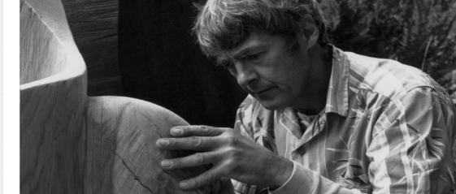
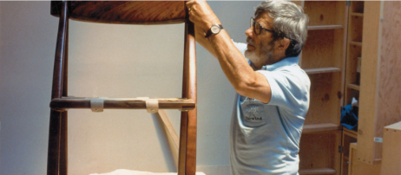
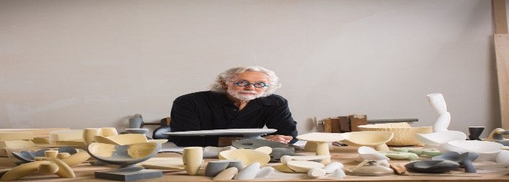
Examples of three contemporary wood artists
The following is a list of three modern wood artists in the American Craft History
J.B Blunk
Arthur Espenet Carpenter
Wendell Castle
("CRAFT IN AMERICA | ARTISTS BY A–Z", 2018)
Notes:
J.B Blunk(1962-2002) is a sculptor of wood known for his unique pieces of work both in their size and the degree of creativity. Arthur Espenet Carpenter (1920-2006) is a woodworker who was declared a Living California Treasure in 1984 for his sleek and unique furniture. Wendell Castle (1932-2018) is known for his furniture designs. His creations in wood, plastic and bronze are uniquely made.

Slide 6
J.B Blunk
He is an artist known for working on wood
He sculpted between 1926 and 2002
He served in the United States Army in Korea
He travelled to Japan where he was able to further his knowledge and skills
On returning to the United States he, eventually, was able to build his own home and studio.
He started working on wood in 1962. He is known to have crafted furniture and installations out of redwood which were very unique.
Some examples of his works include the Dream Lock (1982) and The Planet (1969) ("CRAFT IN AMERICA | ARTISTS BY A–Z", 2018)
Notes:
J.B. Blunk (1926-2002) was a sculptor mainly known for crafting wood. It was after serving in the United States Army in Korea that he met
Isamu Noguchi, who was also a sculptor in Japan. He was introduced to pottery training classes with other Japanese potters, Kitaoji Rosanjin and Living National Treasure Toyo Kaneshige. The artist, Blunk, is known to be the first American to apprentice to improve his skills in order to achieve the country’s great ceramic tradition. After his return in United States, Blunk was finally able to build his own home and studio near Inverness, CA. In 1962,he started working on wood and was crafting furniture and installations out of redwood, which were exceptional in their size and degree of creativity. He graduated from UCLA where he was guided in his studies by Laura Andreson. Examples his works include the Dreamlock of 1982 and the Planet of 1969.

Slide 7
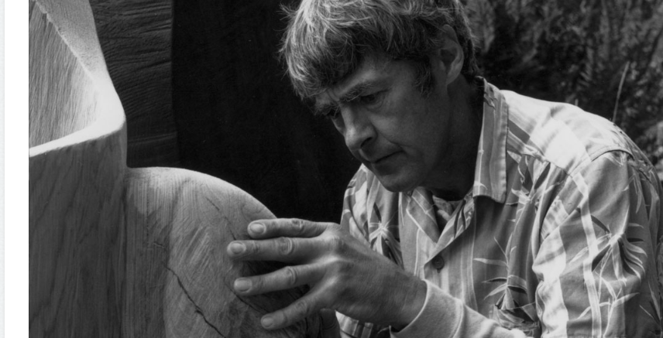
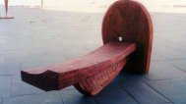
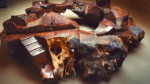
Image of J.B Blunk
J.B. Blunk, Dream lock, 1982. Courtesy J.B. Blunk Estate
J.B. Blunk, The Planet, 1969. Courtesy J.B Blunk Estate
Notes:
The following is the image of J.B Blunk and his pieces of work

Slide 8
Arthur Espenet Carpenter
Arthur Espenet is a Carpenter known for his woodwork from 1920 to 2006.
In 1984, he was declared a Living California treasure
He mostly identified with his sleek and distinctive furniture, for example his wishbone chair and desk as well as music stand
He taught himself woodworking and taught other people
He was a founding member of the Baulines Craft Guild
His works are in Smithsonian Institution and also the Museum of Modern Art as well as the Museum of Arts and Design in New York ("CRAFT IN AMERICA | ARTISTS BY A–Z", 2018)
Notes:
Arthur Espenet Carpenter is known to have worked on wood between 1920 and 2006. The name Arthur is also taken to mean Art. He received a standing ovation in 1984 when he was declared a Living California Treasure. He is widely known for his sleek and unique furniture. Some of his works include the wishbone chair and desk and music stand which had scalloped seashell sides. After attending an exhibition at the Museum of Modern Art in New York, he was inspired to buy a lathe and started teaching himself on woodworking. Arthur was a founding member of the Baulines Craft Guid and taught many woodworkers whom he guided. His pieces of work are in the collection of the Smithsonian Institution and displayed at the Museum of Modern Art and the Museum of Arts and Design in New York.

Slide 9

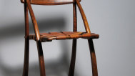
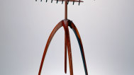
Image of Arthur Espenet Carpenter
Arthur Espenet Carpenter, Wish Bone Chair. Courtesy of Forrest L. Merrill
Arthur Espenet Carpenter, Music Stand. Courtesy of Forrest Merrill, M. Lee Fatheree photograph
Notes:
The following is the image of Arthur Espenet Carpenter and some of his works

Slide 10
Wendell Castle
Wendell is a wood worker artist known to have worked between 1932 and 2018.
He is a furniture maker located in Scottsville in New York.
His furniture creations in wood, plastic and bronze are unique
His place of birth is Emporia, KS.
He has a BFA in Industrial Design from University of Kansas and MFA in sculpture
His works can be traced can be traced in many museums. Some of his works include music stand of 1964 and Dead Eye of 2006("CRAFT IN AMERICA | ARTISTS BY A–Z", 2018).
Notes:
Wendell Castle (1932-2018) is a furniture maker located in Scottsville, New York. His furniture designs in wood, plastic and bronze are unique creations that blur the boundaries between function and sculpture. He was born in Emporia, KS. Wendell graduated from the University of Kansas with his BFA in Industrial Design and MFA in sculpture. His academic appointments are many and his inclusion in one-person and group exhibitions as well as permanent collections is extensive. His work can be found in the Museum of Arts and Design, the Metropolitan Museum of Art, the Mint Museum of Art, Museum of Fine Arts, Museum of Modern Art, among others. Some of his unique collections include the Music Stand of 1964 and the Dead Eye of 2006.

Slide 11
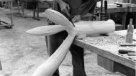
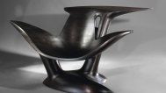

Wendell Castle at Penland School of Crafts. Courtesy of Penland School of Crafts, Dana Moore photograph
Wendell Castle, Dead Eye, 2006. Lazer Inc. photograph
Wendell Castle, Music Stand, 1964. Dirk Bakker photograph
Notes:
The following is the image of Wendell Castle and some pieces of his work.

Slide 12
Conclusion
There is need to recognize art and craft in the world
It portrays the talents that the society has
The natural designs are unique both in their shape and size
Machine-work has replaced artists from their jobs
Wood plays a major role in the art and craft world
There is need to re-invent craftsmanship
Notes:
Art and Craft is a skill that needs to be recognized widely. It portrays the talents that the society has to offer and serves as our identity and legacy. The talent seems to have been replaced by machine-work replacing artists from their jobs. Wood is a major tool that is used by many artists due to its natural feel and the harmony is creates between people and the natural world. It produces unique designs both in their shape and size. There is need to re-produce and re-invent in craftsmanship among members of the modern society today.

Slide 13
References
Obniski, A. (2018). The Arts and Crafts Movement in America | Essay | Heilbrunn Timeline of Art History | The Metropolitan Museum of Art. The Met’s Heilbrunn Timeline of Art History. Retrieved 30 April 2018, from https://www.metmuseum.org/toah/hd/acam/hd_acam.htm
CRAFT IN AMERICA | ARTISTS. (2018). Craftinamerica.org. Retrieved 30 April 2018, from http://www.craftinamerica.org/artists/
Rudumbu, T. (2018). A Brief History of Crafts. American Craft Expo. Retrieved 30 April 2018, from http://americancraftexpo.org/a-brief-history-of-crafts/
Notes:
The following are the resources I consulted for this research

Slide 14
Thank you for listening
Notes:
I would like to thank each one of you for being attentive in my presentation

